Slide 1
EV Charging Demand
-- Data Collection and Forecast
Teng Zeng - 02.13.2018

Slide 2




Introduction
I am From Guangzhou..

Slide 3
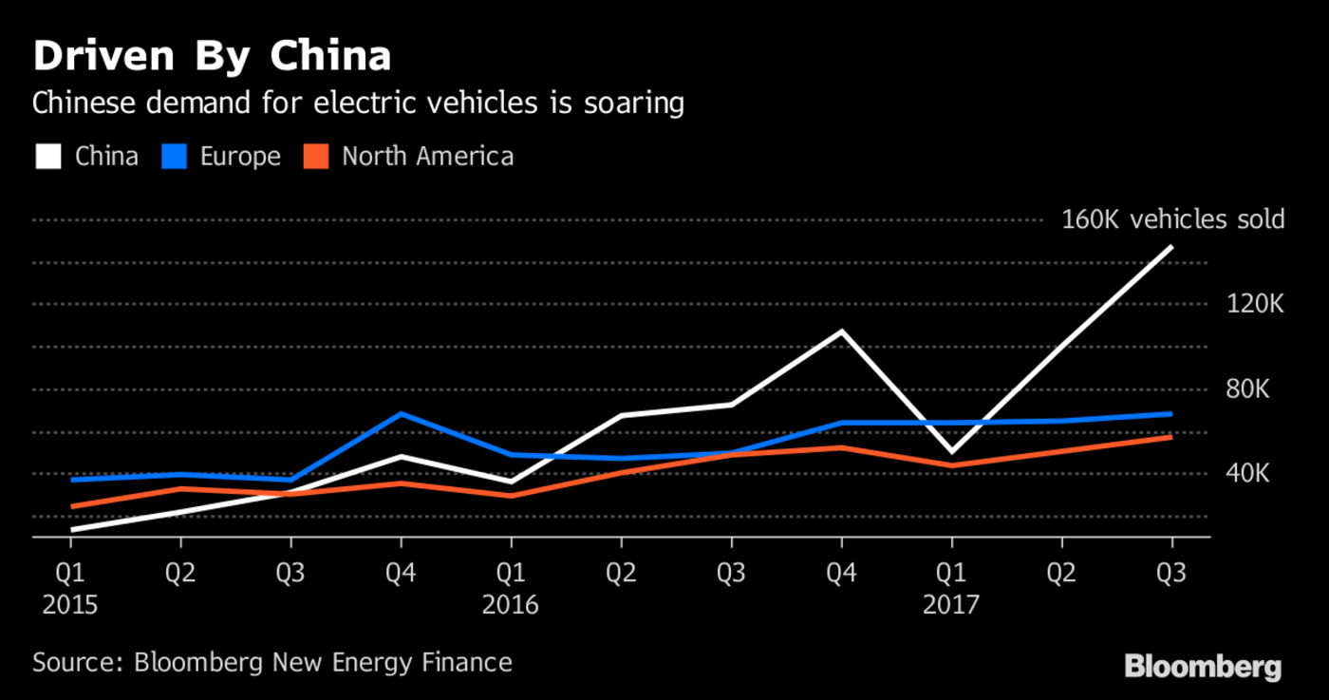
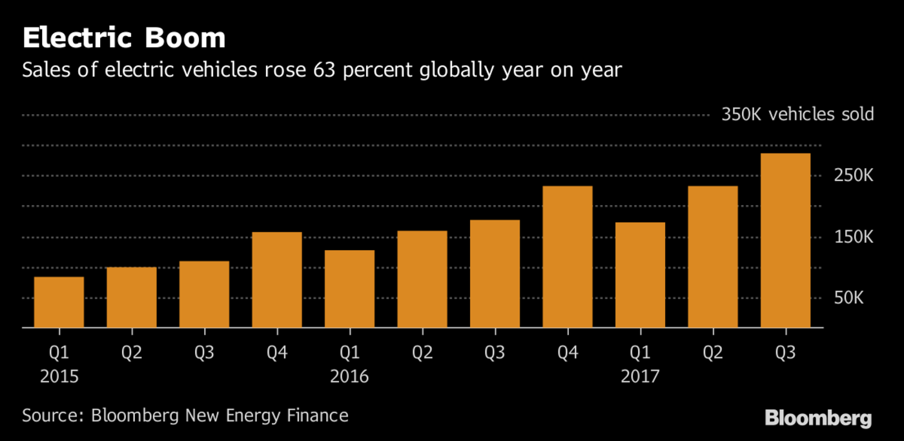
Background - Numbers
Notes:
Worldwide total EV sales reaches 3 million milestone in Nov. 2017, a share of 0.86% of new sale market. Chinese market consumes almost a half of the EV sales worldwide. And then it’s the Europe and North America.
last week's executive order indicated that state government thinks California could realistically grow its EV fleet from 350,000 currently to 5 million in just 12 year

Slide 4
Background - Rising Problems
Residential transformer: 10~50 kVA of load
A 240 V L2 charger : 7 kVA
Peak hour demand:
grid impact - overloading
transformers damage or outages
California 350,000 EVs on the road
“California may need up to 220,000 publicly accessible charging ports by 2020 to meet projected demand, well beyond the roughly 12,000 available today. Hundreds of thousands of additional charging stations will be necessary at multi-unit dwellings.” -- Ethan Elkind, Director of Climate Program Berkeley Law
Notes:
Most residential transformers are designed to serve between 10 and 50kVA of load, while a single plug-in vehicle (PEV) with a 240V Level 2 charging system consumes about 7kVa. If multiple electric car owners use the same distribution transformer (such situation is referred to as clustering), they may cause damage or outages from overloading the equipment or by shortening their normal cool-down period. This significantly impact the quality of service of a utility company.
The Sacramento Municipal Utility District, for example, has recognized that about 17% of the company’s transformers may need to be replaced as a result of EV-related overloads, at an average estimated cost of $7,400 per transformer.
Previous six years saw a 1,300-percent increase in the number of zero-emissions vehicles in the state.

Slide 5

Solutions?
Transformer
Power System Upgrade
Distribution Network
Peak Shaving
Smart Charging
Load Demand Profile
Historical Data?
Ancillary Service
More Charging Outlets
Notes:
Profile: very short, hourly and daily or mid term, weekly and monthly or even long term annually

Slide 6
Data Scraping Overview
What is data scraping
Why do we scrape data
Data scraping techniques state-of-art
Speedup: Parallel Computing
Hide: Tor (onion routing), HTTP/HTTPS proxy
Natural human behavior:
randomize requesting time
interval length
requesting device

Slide 7
Data Scraping Overview
What is data scraping
Why do we scrape data
Data scraping techniques state-of-art
Speedup: Parallel Computing
Hide: Tor (onion routing), HTTP/HTTPS proxy
Natural human behavior:
randomize requesting time
interval length
requesting device

Slide 8




Data Scraping
Definition:
Data Scraping, AKA Web Scraping, is a technique employed to extract large amounts of data from websites whereby the data is extracted and saved to a local file in your computer or to a database in table (spreadsheet) format.
URL
DNS Analysis
HTML Tree
Store

Slide 9
Problems
•Understand the webpage HTML structure
•Low efficiency if pages are hard to recognize
•Crawler needs to be able to go through page by page
•Following scraping morality, DNS attack
•Servers require ID verification (anti-scraping)

Slide 10



My Data Scraping – Phone APP
Motivation:
Detailed information available on phone app
Innovation:
Intercept the cell phone connections – unencrypted
Camouflaged the computer as a “hungry” cell phone
Host (cell phone – server API)
Headers (device version, app version)
Specific parameters (pile ID codes)
DNS Analysis
Server API
Store
Notes:
Host (cell phone – server API)
Headers (device version, app version)
Specific parameters (pile ID codes)

Slide 11

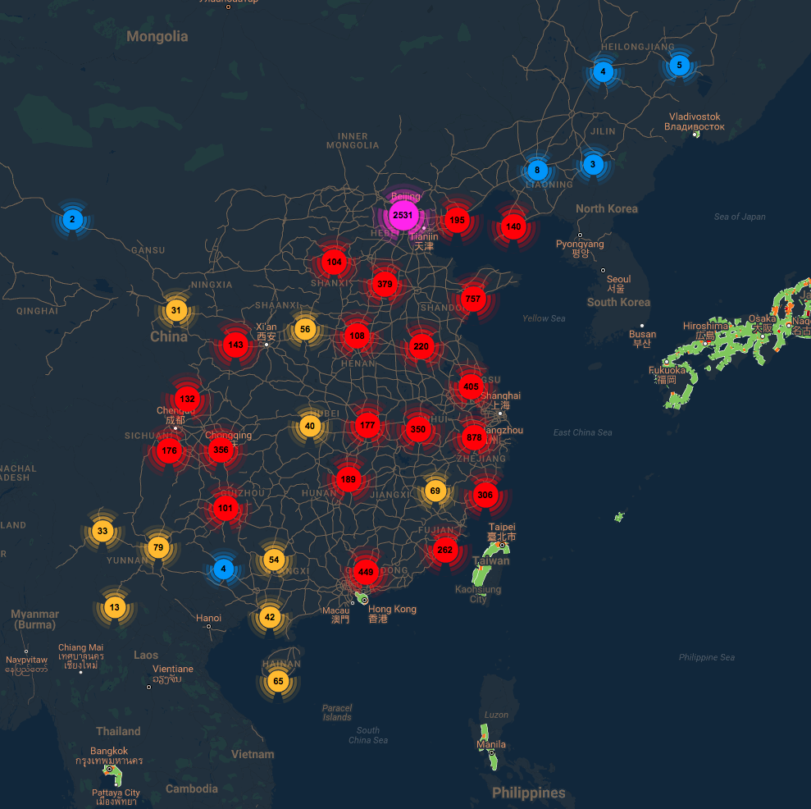
Target:
Teld is..
an EV charging station service provider.
an EV charger manufacturer.
a smart charging solution designer.
Teld has..
Largest charging station network in China.
196,321 charging outlets in total.
282 cities covered.
Notes:
Provide charging service solution tailored to the majority of electric vehicle users. It is used in conjunction with the world's leading smart charging system to create an intelligent charging mode that makes charging easier, safer and more reliable.

Slide 12
System Framework
Research
Visualization
Analytics
Public
PostgreSQL Database
Scraping Subsystem 1
Scraping Subsystem 2
...
...
Scraping Subsystem N
Teld Database

Slide 13
Database
Pile State Table
pillCode *
stateCode
stateName
time
PostgreSQL
Relational database
Station Table
Pile Table
User Activity Table
operatorName
priceDesc
score
slowTerminalNum
stationAddress
stationId **
stationName
stationType
pillcode *
prices
opState
stationId **
staName
terminalType
carTypeName
pileName
startTime
stationId **
userNickName
Pile Table

Slide 14
Current Stage
Data size: 622MB (>100 stations with 1500 outlets)
Day of activities:
~102 days recorded
15-30 minutes interval
Type of charging station:
residential, workplace, industrial park, hotel
Type of EVs:
BAIC EX200, BAIC EU260, BYD e5, BYD Song, BMW i3..
Notes:
Oct. 10th - Dec. 24th 2017, Jan. 18th - Present 2018

Slide 15
Questions
EV charging station demand profile, i.e. load forecasting
If the company/Shenzhen city wants to deploy another 1000 charging stations, where shall they be?
How to improve the station conditions to raise EV drivers user satisfactory rating?
Notes:
Establish the profile

Slide 16
Questions
EV charging station demand profile, i.e. load forecasting
If the company/Shenzhen city wants to deploy another 1000 charging stations, where shall they be?
How to improve the station conditions to raise EV drivers user satisfactory rating?

Slide 17
Load Forecasting
Definition:
Load forecasting is a technique mainly used by utility companies to predict the power/energy needed to meet the demand and supply equilibrium within a specific time interval.
Dr. T. Hong’s Must-know basics of forecasting:
All forecasts are wrong
Accuracy is never guaranteed
Citation: T. Hong, David A. Dickey, Electric load forecasting: fundamentals and best practices
Notes:
Forecasting is stochastic problem. Since we forecasters are de45aling with randomness, the output of a forecasting process is supposed to be in a probabilistic form.
In practice, a lot of decision making processes today cannot yet take probabilistic inputs, so the most commonly used forecasting output form is still point forecast, e.g., the future expected value of a random variable.

Slide 18
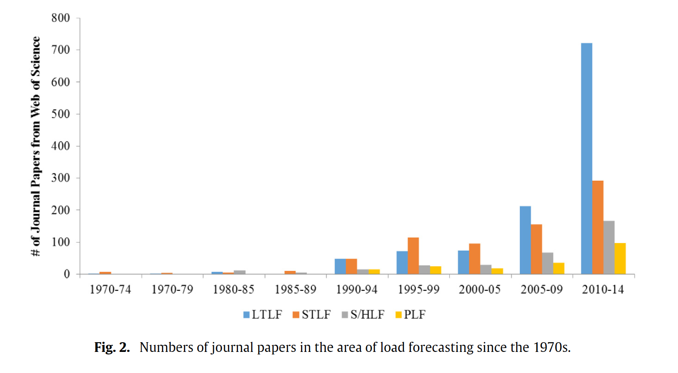
History of Load Forecasting
“Load Forecasting Bibliography Phase I” & “Load Forecasting Bibliography Phase II” are published in the early 1980s by IEEE Transactions on Power Apparatus and Systems [1][2].
Earliest literature of load forecasting dates back to at 1918 [3].
Citation: T. Hong, S. Fan Probabilistic electric load forecasting: a tutorial review Int J Forecast, 32 (3) (2016), pp. 914-938, 10.1016/j.ijforecast.2015.11.011

Slide 19
Classification of Load Forecasting
Very Short Term Load Forecasting
Household LF
Short Term Load Forecasting
Charging Station LF
Load Forecasting (LF)
Grid LF
Mid Term Load Forecasting
Natural Gas LF
Long Term Load Forecasting

Slide 20
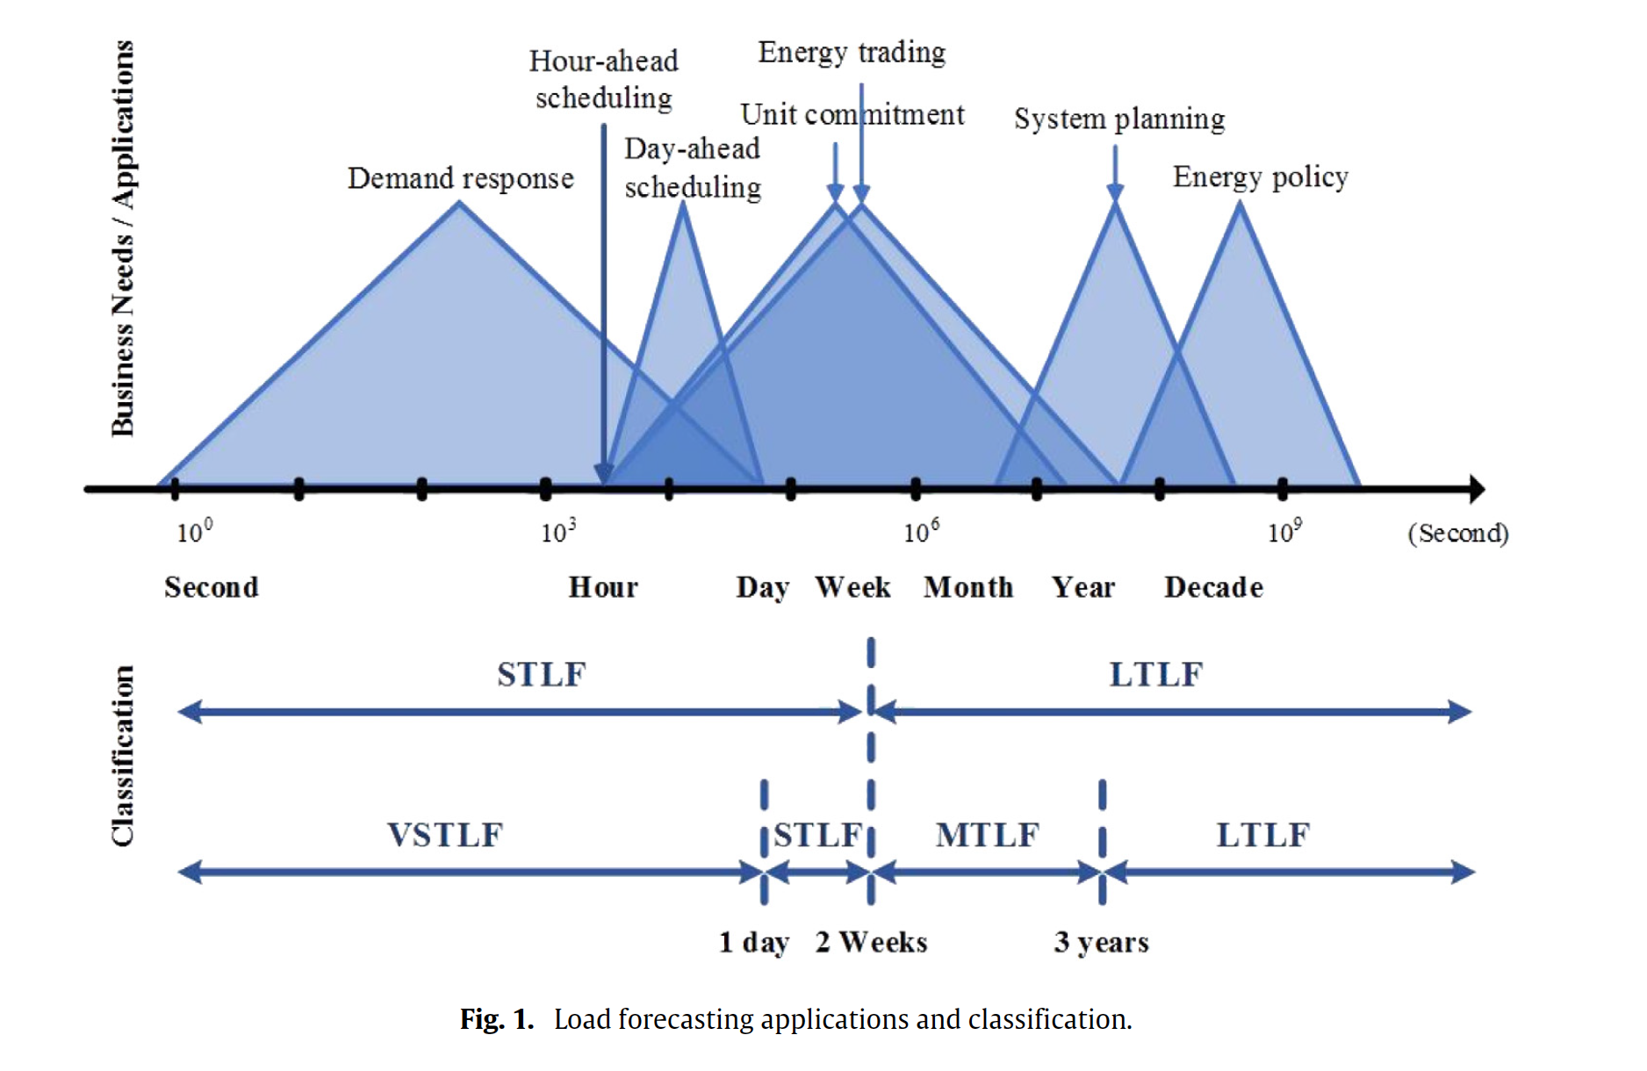
Citation: T. Hong, S. Fan Probabilistic electric load forecasting: a tutorial review Int J Forecast, 32 (3) (2016), pp. 914-938, 10.1016/j.ijforecast.2015.11.011

Slide 21
Classification of Load Forecasting
Very Short Term Load Forecasting
Household LF
Short Term Load Forecasting
Charging Station LF
Load Forecasting (LF)
Grid LF
Mid Term Load Forecasting
Natural Gas LF
Long Term Load Forecasting
Notes:
With special interest, we are interested in the short term load forecasting for charging station, from perspective from either understanding the next day load demand or participating in the energy market

Slide 22
EV Charging Station Load Forecasting LIT Review
Author | Methods | Results | Missing?
Erotokritos Xydas | 1. Clustering, 2. Correlation, 3. Regression, 4. Fuzzy-logit model | Identified potential underlying risks | 1. Exact daily charging demand profile, 2. Model accuracy
Mariz B. Arias | 1. Clustering, 2. Relational analysis, 3. Decision tree | Different charging load profiles generated | 1. Too many assumptions, 2. Benchmark model
Kuan Lu | 1. Fuzzy C-Mean clustering, 2. SVM-regression, 3. Genetic Algorithm, 4. Particle Swarm Optimization | RMSE = 9.79% | 1. Unspecified type of EV charging station, 2. Generalizability
Notes:
[5]
Historical load, and weather data
Results: Three zones’ respective potential underlying risks from the given characteristics are identified.
[6]
Historical traffic volume and weather data
Results: Scenarios: weekdays, weekends, summer, winter; residential and commercial sites.
[10]
One charging station from Qingdao
Data: Data period ranges from 4.1 to 6.30 2017
Results: Empirical analysis results show that the daily load forecasting error of an EV charging station is 9.79%, which basically meets the requirements of an EV charging station’s daily control.

Slide 23
Author | Methods | Results | Missing?
Mostafa Majidpour | 1. KNN, 2. Weighted-KNN, 3.Time-weighted dot product dissimilarity measure (new) | More effective dissimilarity measurement | 1. Basic machine learning techniques 2. Assumption of TWDP
Mostafa Majidpour | 1. KNN, 2. ARIMA, 3. Pattern Sequence Forecasting (PSF), 4. Modified PSF (new) | 1. KNN with k = 1 performs the best in terms of SMAPE 2. PSF performs the worst 3. MPSF more effective than PSF
Mostafa Majidpour | 1. NN-TWDP, 2. SVM, 3. MPSF, 4. Random Forest (RF) | 1. Statistically significant difference between prediction results for NN-TWDP, MPSF 2. Customer profile based prediction is faster but privacy invading. | Only scenarios around UCLA campus
Notes:
[7]
Miss: After clustering, the predicted profile is taken by averaging the cluster. Could cause problem if big difference between actual peak and predicted peak
[8]
Results: A new method combining robustness towards noise (PSF) and lower error (KNN) is proposed (MPSF)
[9]
Results:
1.For NN-TWDP and MPSF algorithms, there is a statistically significant difference between prediction results when different dataset.
2. Customer profile based prediction is faster due to less preprocessing (twice as faster) but it is privacy invading.
Missing?
1. no residential, commercial, hospital, etc.

Slide 24
VSTLF
Clustering
Household Electric LF (ELF)
Correlation
Traffic Data
Decision Tree
STLF
Station ELF
KNN
Load Data
Load Forecasting (LF)
Weighted-KNN
Grid ELF
PSF
MTLF
ARIMA
Natural Gas LF
ANN
SVM
LTLF

Slide 25
Approach One: Traffic Data
Title: Electric vehicle charging demand forecasting model based on big data technologies
Summary:
The forecasting model uses historical real-world traffic and weather data.
The model considers charging demand for both EVs and electric buses.
The model considers both slow and fast charging classifications.
“The proposed EV charging demand model can be the foundation for the research on the impact of charging EVs on the power system”
Notes:
This paper presents a forecasting model to estimate electric vehicle charging demand with historical traffic data and weather data of South Korea.
Scenarios: weekdays and weekends , summer and winter, at residential and commercial were presented to show the different charging load profiles of EVs in the residential and commercial sites.

Slide 26
Approach One: Traffic Data
Title: Electric vehicle charging demand forecasting model based on big data technologies
Data:
Traffic data:
The data includes daily traffic volumes and vehicle mileages by vehicle types collected in the highway, national route, and local roads of South Korea in every hour for a year.
Assumption: EV traffic patterns will be identical with the real traffic data of conventional vehicle.
Weather data: temperature, humidity, wind speed
Relational Analysis
Decision Tree
Cluster #
Gaussian Sampling
Classification
Decision
Cluster Analysis

Slide 27
Approach One: Traffic Data
Title: Electric vehicle charging demand forecasting model based on big data technologies
Methodology:
Cluster Analysis:
Motivation: Traffic volume consists of different traffic patterns resulted from various factors such as weather and day types.
Four types of cars traffic pattern and two types of buses traffic pattern are identified
Car cluster 1 | Event days & festivals
Car cluster 2 | Weekdays & Saturdays
Car cluster 3 | Holidays
Car cluster 4 | Sunday
Bus cluster 1 | Weekends
Bus cluster 2 | Weekdays

Slide 28
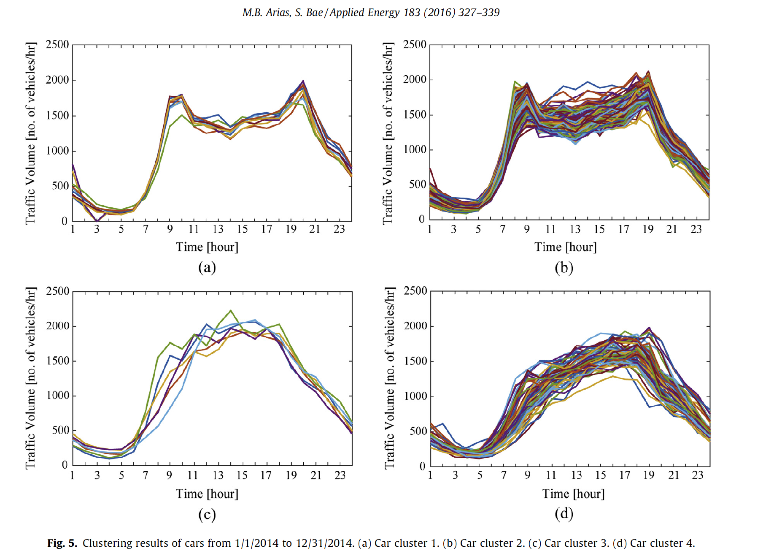
Approach One: Traffic Data
Title: Electric vehicle charging demand forecasting model based on big data technologies

Slide 29
Approach One: Traffic Data
Title: Electric vehicle charging demand forecasting model based on big data technologies
Methodology:
Relational Analysis:
Motivation:
Important factors that have a significant influence on the traffic patterns.
Important factors:
maximum temperature, average temperature, average humidity, average wind speed, day type
Decision Tree:
Motivation:
Establish the relationship between the formed clusters of traffic patterns and influential factors.

Slide 30
Approach One: Traffic Data
Title: Electric vehicle charging demand forecasting model based on big data technologies
Take away:
Decision tree for influential factors and traffic volume/charging pattern.
No accuracy testing was done.
Too many assumptions on EVs charging profile.
No comparison/benchmark model to compare the effectiveness of the model.

Slide 31
Approach Two: Load Data
Titles:
Modified Pattern Sequence-based Forecasting for Electric Vehicle Charging Stations
Fast Demand Forecast of Electric Vehicle Charging Stations for Cell Phone Application
Forecasting the EV charging load based on customer profile or station measurement?
Summary:
K-NN, ARIMA, Pattern Sequence Forecasting (PSF), Modified PSF,
K-NN and weighted k-NN, new method proposed (TWDP),
TWDP-NN, MPSF, SVR, RF
Eight models tested for forecasting of energy consumption at individual EV charging outlets.
Data: Historical load data from outlets that have more than 60 effective days of data (start time, end time, energy drawn). These outlets are installed on UCLA campus
Notes:
15
20
28
Weighted k-NN uses Dudani;s weights
TWDP: time weighted dot product

Slide 32
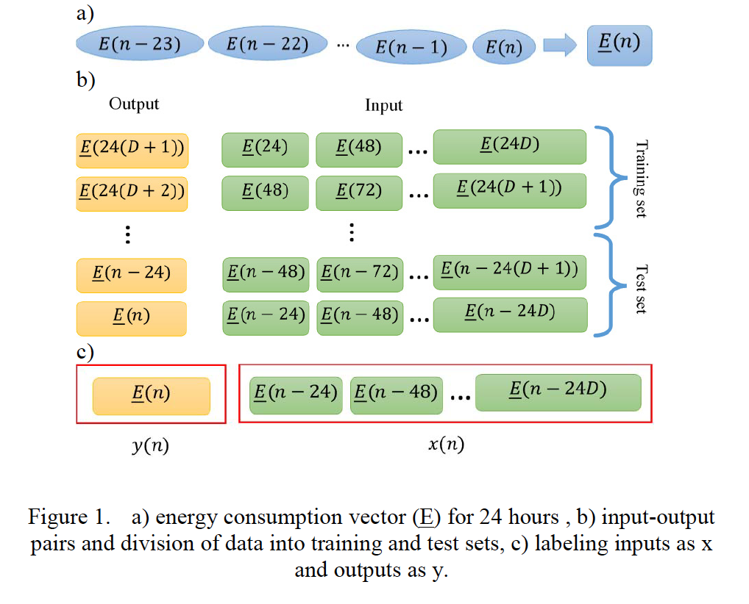
Approach Two: Load Data
Titles:
Modified Pattern Sequence-based Forecasting for Electric Vehicle Charging Stations
Fast Demand Forecast of Electric Vehicle Charging Stations for Cell Phone Application
Forecasting the EV charging load based on customer profile or station measurement?
Methodology:
K-Nearest Neighbor
Time weighted Dot Product
Polynomial kernel similarity
+ Linear time weighting

Slide 33
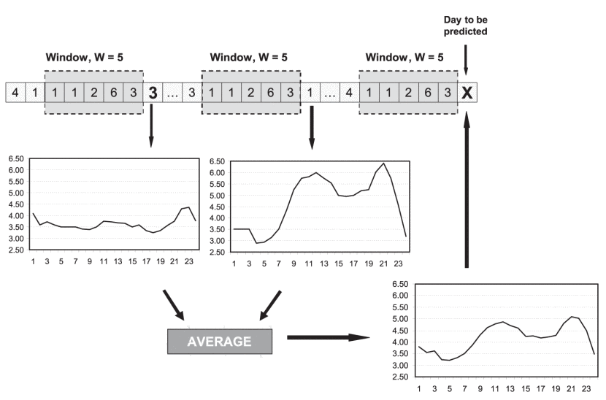
Approach Two: Load Data
Titles:
Modified Pattern Sequence-based Forecasting for Electric Vehicle Charging Stations
Fast Demand Forecast of Electric Vehicle Charging Stations for Cell Phone Application
Forecasting the EV charging load based on customer profile or station measurement?
Methodology:
ARIMA
Pattern Sequence-base Forecasting (PSF)
Dimension Reduction
Modified PSF
PSF might present ill-condition optimum clusters
PSF fails when there is no match for a sequence even whose length is one.
Notes:
1. PSF categorizes data into two clusters, zero-day and non-zero day

Slide 34
Approach Two: Load Data
Titles:
Modified Pattern Sequence-based Forecasting for Electric Vehicle Charging Stations
Fast Demand Forecast of Electric Vehicle Charging Stations for Cell Phone Application
Forecasting the EV charging load based on customer profile or station measurement?
Take away:
NN has the lowest SMAPE: previous day’s load data is very crucial to next day load forecasting.
MPSF decreases the SMAPE by almost 30% as compared to PSF.
TWDP dissimilarity measurement decreases the SMAPE by about 4-6%.
SVR and RF almost double the SMAPE of NN-TWDP and MPSF

Slide 35
Notes
Techniques varies from time-series prediction, to regression prediction, to neural network prediction. No commonly recognized benchmark model to compare about. Can we draw connections between these methods?
Among these paper, a combination of weather and historical load data forecasting research is missing. Will bring in influential weather data enhance the accuracy of the forecasting model?

Slide 36
Notes
Can we forecast a charging station without its historical charging data (at the least maybe understand how many l1, l2 types of charger are needed for the new location)?
Scenario classes:
Weather (hot, cold, cool, rain, snow),
Season (winter, summer),
Charging station characteristics:
Types - residential, commercial, hospital, hotel, etc.
Locations - neighborhood population, neighborhood occupations
Service ratings - environment, queuing time, prices
Probabilistic electric load forecasting is a hot topic.
Notes:
Perform various charging station load forecasting under different scenarios for different types of charging station, i.e. exploring more variables impact on charging station load demand.

Slide 37
Reference
[1] G. E. Huck, A. A. Mahmoud, R. B. Comerford, J. Adams, and E. Dawson, "Load Forecast Bibliography Phase I," IEEE Transactions on Power Apparatus and Systems, vol. PAS-99, pp. 53-58, 1980.
[2] A. A. Mahmoud, T. H. Ortmeyer, and R. E. Reardon, "Load Forecasting Bibliography Phase II," IEEE Transactions on Power Apparatus and Systems, vol. PAS-100, pp. 3217-3220, 1981.
[3]T. Hong, Short Term Electric Load Forecasting
[4] T. Hong, S. Fan, Probabilistic electric load forecasting: a tutorial review Int J Forecast, 32 (3) (2016), pp. 914-938, 10.1016/j.ijforecast.2015.11.011
[5] Xydas E, Marmaras C, Cipcipgan L, Jenkins N, Carroll S, Barker M, A data-driven approach for characterising the charging demand of electric vehicles: a UK case study. Appl Energy 2016;162:763–71. http://dx.doi.org/10.1016/j.apenergy.2015.05.057
[6] M.B. Arias, S. Bae, Electric vehicle charging demand forecasting model based on big data technologies Applied Energy, 183 (2016), pp. 327-339. http://dx.doi.org/10.1016/j.apenergy.2016.08.080
[7] M. Majidpour C. Qiu C-Y. Chung P. Chu R. Gadh H. Pota "Fast Demand Forecast of Electric Vehicle Charging Stations for Cell Phone Application" <em>Proc. IEEE/PES General Meeting</em> 27-31 July 2014.
[8] M. Majidpour, C. Qiu, P. Chu, R. Gadh, H. R. Pota, "Modified pattern sequence-based forecasting for electric vehicle charging stations", Smart Grid Communications (SmartGridComm) 2014 IEEE International Conference on, pp. 710-715, 3-6 Nov. 2014.
[9] M. Majidpour, Ch. Qiu, P. Chu, H. Pota, R. Gadh, Forecasting the EV charging load based on customer profile or station measurement? Appl. Energy, 163 (2016), pp. 134-141
[10] Kuan Lu et al Load forecast method of electric vehicle charging station using SVR based on GA-PSO 2017 IOP Conf. Ser.: Earth Environ. Sci. 69 012196

Slide 38



